Slide 1
Mortality Predictor for Intensive Care Units (ICUs)
Predictive Modelling in Healthcare: Course Summary Project
Liat Cohen
Yarin Hayun
Amit Shakarchy

Slide 2


First meeting with the Dr. Jane Smith, head of the ICU
What can we do with the retrospective EMR data in Dr. Jane’s unit

Slide 3
Mortality predictor for ICUs
We will develop a prediction model, to predict the mortality risk of patients admitting the ICU
Age: 25
Gender: Female
Allergies: None
Location: Madrid
Prediction model
Predicted
mortality risk:
0.2%

Slide 4
Uses of a mortality prediction model
Decide who needs to be admitted to the ICU
Assess the extent of the intervention measures that should be used
Prepare families towards end-of-life decisions
Assess the effect of medical interventions on the mortality risk of a patient

Slide 5
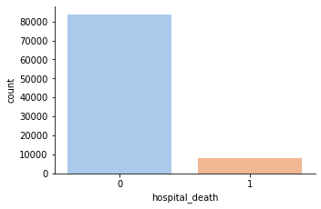
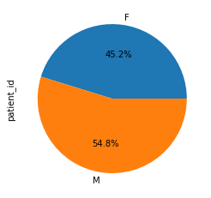
General descriptives of the data set
Distribution of death in the ICU
Gender distribution
(91.37%)
(8.63%)

Slide 6
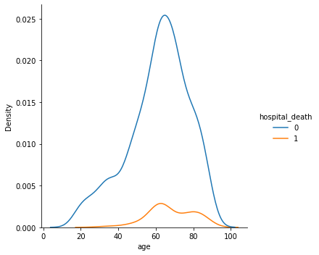
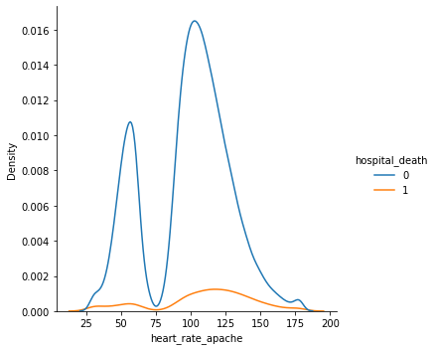
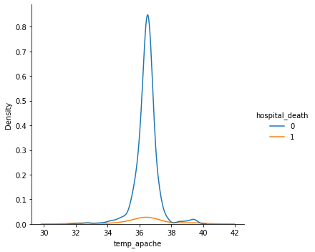
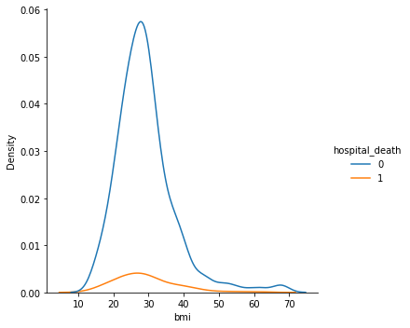
General descriptives of the data set (2)

Slide 7
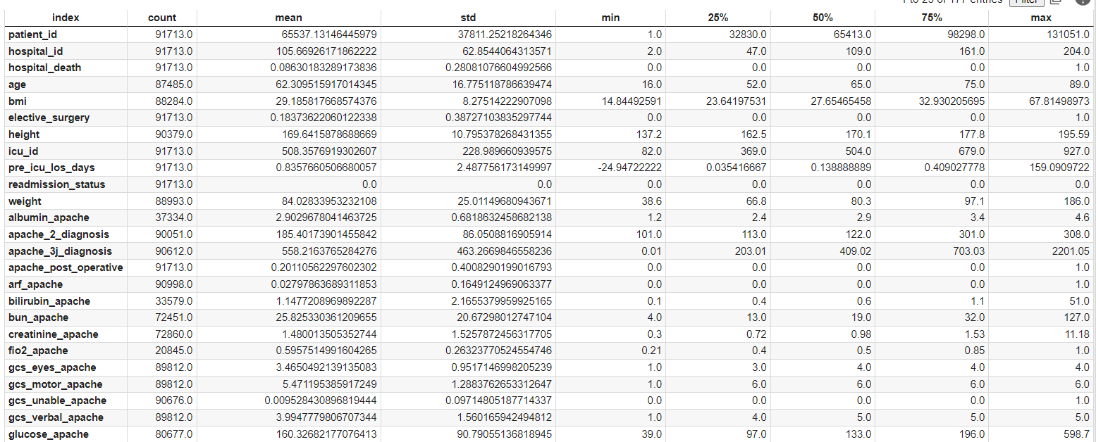
General descriptives of the data set (3)

Slide 8
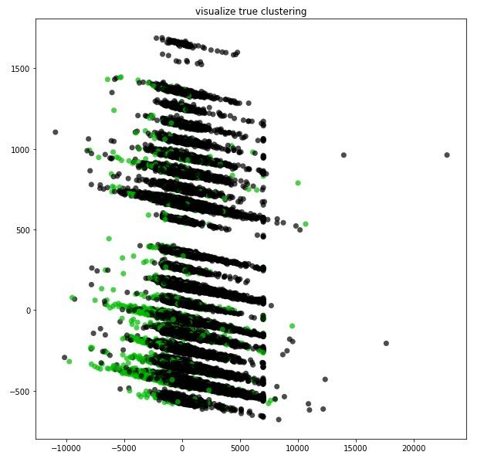
Visualization of the data in 2D (with PCA dimensionality reduction)
General descriptives of the data set (4)
Died in the ICU
Lived

Slide 9

Second meeting: first modelling results
We will present 2 modelling alternatives

Slide 10
XGBoost
Extreme Gradient Boosting is a decision tree ensemble learning algorithm for classification and regression, designed for speed and performance.
Ensemble learning algorithms combine multiple machine learning algorithms to obtain a better model.
The algorithm has recently been dominating applied machine learning and Kaggle competitions for structured or tabular data

Slide 11
XGBoost- pros and cons
pros
cons
Effective with large data sets
Do not need normalized features
Has an in-built capability to handle missing values.
Tends to over-fit the data
Relatively slow

Slide 12
CatBoost
Based on gradient boosted decision trees. During training, a set of decision trees is built consecutively. Each successive tree is built with reduced loss compared to the previous trees.
We can use CatBoost without any explicit pre-processing to convert categories into numbers. CatBoost converts categorical values into numbers using various statistics on combinations of categorical features
CatBoost provides state of the art results and it is competitive with any leading machine learning algorithm on the performance front.

Slide 13
CatBoost- pros and cons
pros
cons
It gives us great results for categorical data
It can train our model on GPU that significantly increase the speed of learning
It performs only better than other algorithms only when we have categorical data
Can perform very bad if the variables are not properly tuned

Slide 14
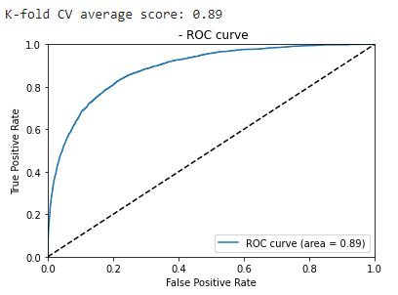
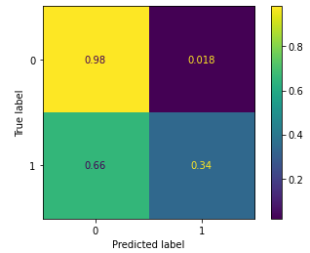
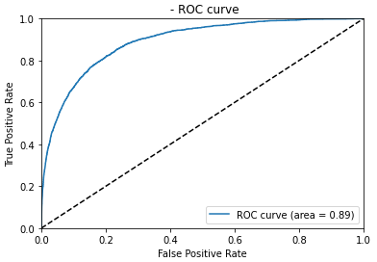
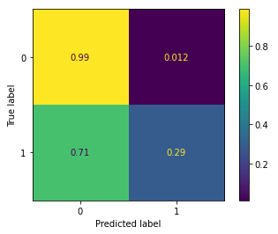
First Modeling Results
CatBoost
XGBoost
Notes:
catboost

Slide 15
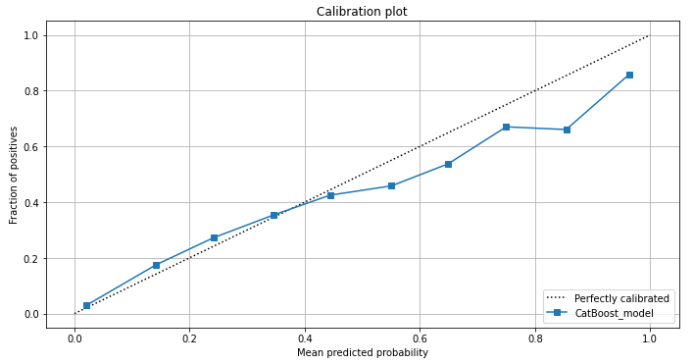
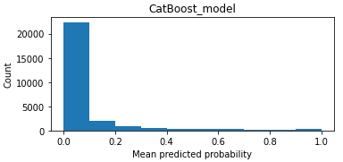
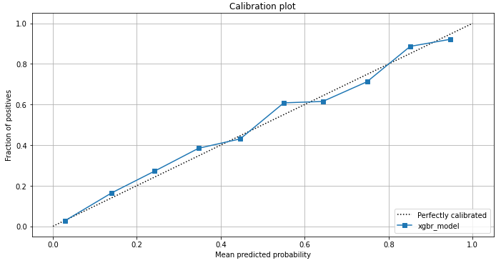
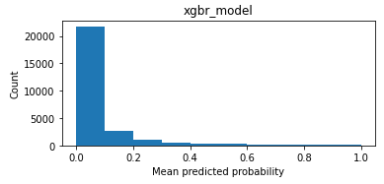
Calibration comparison
CatBoost
XGBoost
Notes:
catboost

Slide 16
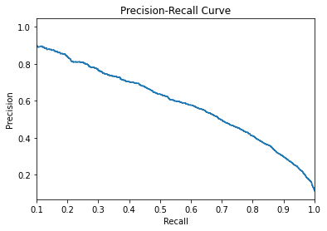
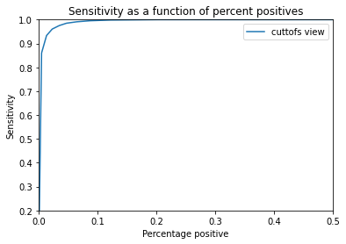
Performance charts- XGBoost (cont.)
Notes:
catboost

Slide 17
Potential Intervention cut-offs
Percent positive | 2 %
Sensitivity | 86%
PPV | 50%
2% of the population. Identifies 86% of those who will die in the ICU; if someone is identified at this risk, he/she has a risk of 50% of mortality.
Percent positive | 5%
Sensitivity | 97%
PPV | 71%
5% of the population. Identifies 97% of those who will die in the ICU; if someone is identified at this risk, he/she has a risk of 71% of mortality.
Percent positive | 10%
Sensitivity | 99%
PPV | 81%
10% of the population. Identifies 99% of those who will die in the ICU; if someone is identified at this risk, he/she has a risk of 81% of mortality.

Slide 18


third meeting: explainability
Global & local explainability alternatives

Slide 19
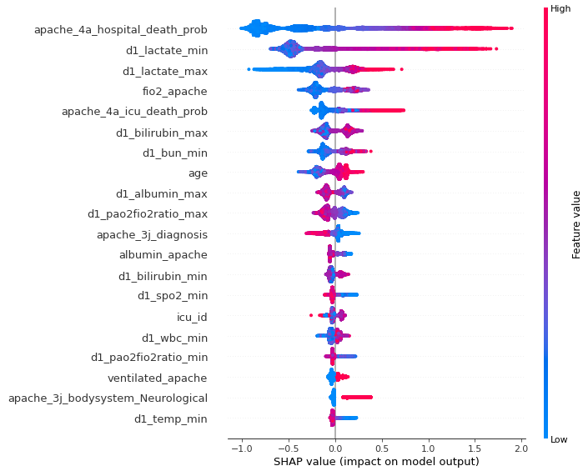
Global Explainability

Slide 20
Local Explainability
Age: 86, Gender: male, bmi: 30.863, ethnicity: caucasian
Model’s prediction: hospital death , true label: hospital death

Slide 21
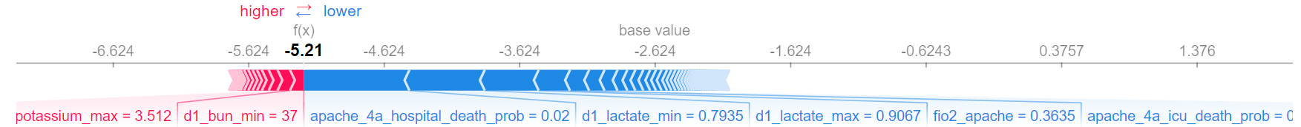
Local Explainability (cont.)
Age: 64, Gender: male, bmi: 25.027 ethnicity: Asian
Model’s prediction: no hospital death , true label: no hospital death

Slide 22

Fourth meeting: missing data
How performance is affected by different alternatives of dealing with missing data

Slide 23
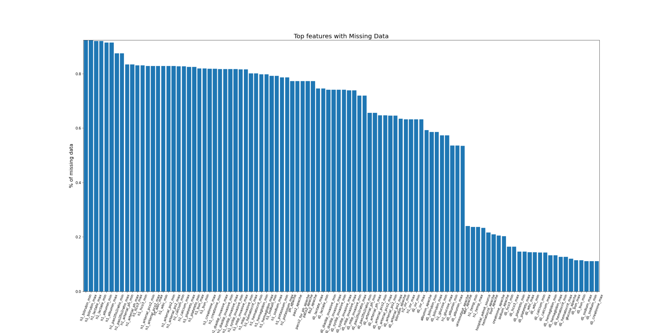
Missing Values
We found a great amount of missing values in the dataset.
Some columns had more than 80% of missing information so we had to discard those columns.
For the rest of the columns, We tried several methods to handle the missing values.

Slide 24
Alternatives for missing values
Complete case analysis
Keep the missing
Drop all rows with missing values
Keep missing values and let the model handle them internally
Add missing category
imputation
Add ‘missing’ category for categorical variables and d masking column for numerical variables
Using various imputation alternatives

Slide 25
Results of different missing value alternatives
AUC Scores
Complete case
0.770%
Keep missing values
0.895%
Add a “missing” category
0.895%
Simple imputation
0.893%
Multi imputation
0.928%

Slide 26
Imputed features- examples
d1_lactate_max
d1_lactate_min
albumin_apache
d1_albumin_min
d1_albumin_max
bilirubin_apache d1_bilirubin_min
d1_bilirubin_max
creatinine_apache

Slide 27
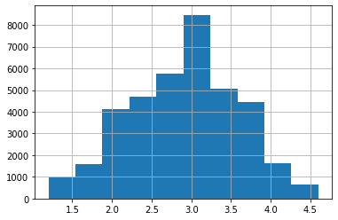
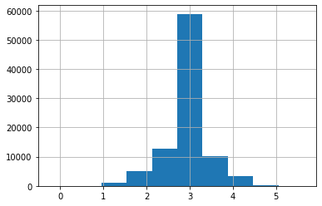
Imputed values- examples
albumin_apache
Values distribution- not imputed
Values distribution- imputed

Slide 28
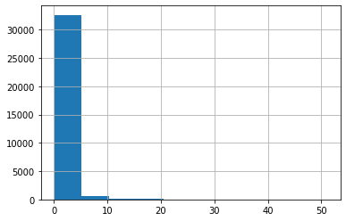
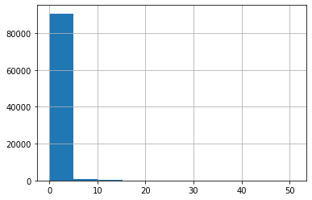
Imputed values- examples
bilirubin_apache
Values distribution- not imputed
Values distribution- imputed

Slide 29

Fifth meeting: Uncertainty
A description of the uncertainty in our results

Slide 30
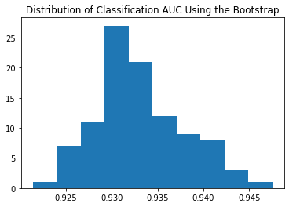
Global uncertainty: bootsraps
There is a 95.0 likelihood that the confidence interval 92.5% and 94.4% covers the true skill of the model

Slide 31

Sixth meeting: potential unfairness in the model
General considerations of potential fairness issues regarding the mortality predictor, and how we address them

Slide 32
Potential unfairness
Populations which are underrepresented in the training set often receive non-accurate predictions.
Our mortality predictor might be unfair to minority groups

Slide 33
Potential unfairness (2)
We will explore the model’s performance on with regard to several protected variables:
Age
Gender
Varies between 20-90
Male/Female
ethnicity
hospital the patient was admitted to
African-american, Native-american, Hispanic, Asian or Caucasian
Out of 200 hospitals

Slide 34
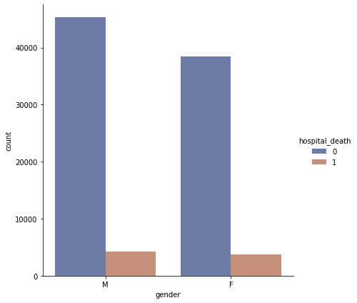
Fairness - Gender
AUC Scores
Male
0.927%
Female
0.93%

Slide 35
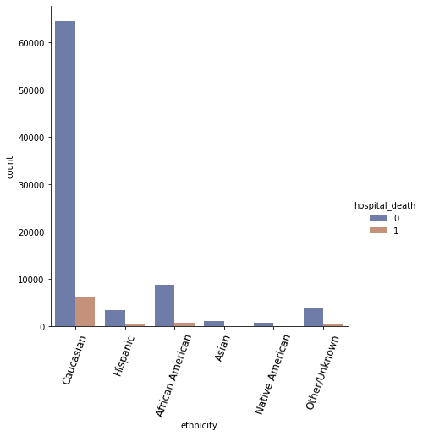
Fairness - ethnicity
AUC Scores
African American
0.919%
Asian
0.926%
Caucasian
0.927%
Hispanic
0.934%
Native American
0.953%
Other
0.944%

Slide 36
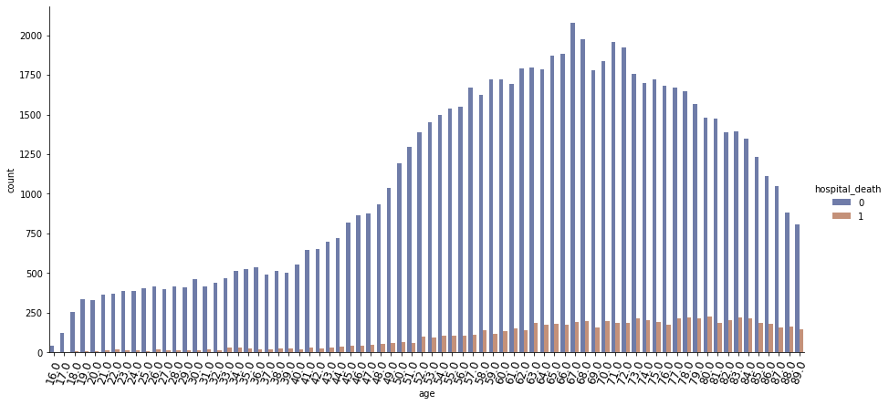
Fairness – Age
Subgroup | AUC with the feature
Total | 0.928
0 - 38 | 0.9468
38 – 50 | 0.9452
50 – 61 | 0.9405
61 – 63 | 0.9231
63 - 67 | 0.9235
67 – 71 | 0.9185
71 - 76 | 0.9202
76 - 82 | 0.9152
82 - 90 | 0.9016

Slide 37
Possible approaches to deal with potential unfairness
Remove the protected variable from the training set (we will implement this option)
Equalizing error rate (TPR, FPR, etc.); AKA “Error rate parity”
Equalizing calibration
Notes:
Suggest approaches to dealing with potential unfairness (if you can, try to implement some of them)

Slide 38
Fairness – ethnicity: build a model without ethnicity feature
Subgroup | AUC with the feature | AUC without the feature
Total | 0.928 | 0.927
African American | 0.9197 | 0.9194
Asian | 0.9265 | 0.9266
Caucasian | 0.9276 | 0.9275
Hispanic | 0.9349 | 0.9347
Native American | 0.9536 | 0.9532
Other | 0.9448 | 0.9447

Slide 39
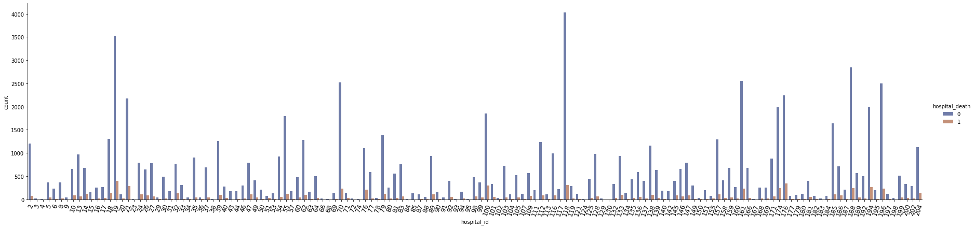
Fairness – Hospital ID
Subgroup | Total | 0 - 19 | 19 – 32 | 32 – 55 | 55 – 83 | 83 – 112 | 112 – 133 | 133 - 160 | 160 - 176 | 176 - 192
AUC with the feature | 0.928 | 0.9244 | 0.9267 | 0.9334 | 0.9221 | 0.933 | 0.9292 | 0.9438 | 0.9336 | 0.933
AUC without the feature | 0.928 | 0.9237 | 0.9268 | 0.933 | 0.9223 | 0.9331 | 0.9292 | 0.9436 | 0.9332 | 0.9329

